Slide 1
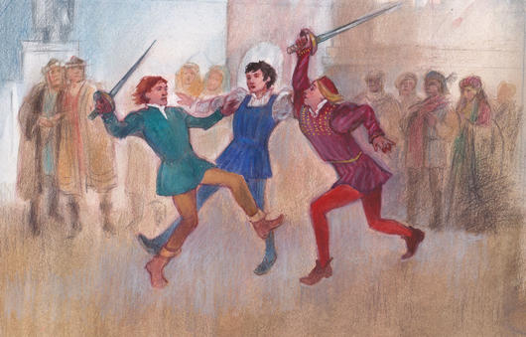
Act 1, Scene 4 & 5: Mercutio and the Capulet Party
Stop in the name of love!
He started it!
But he bit his thumb at me!
We have already seen how the play opens in the prologue, with key themes such as love and hate introduced to the audience by the chorus. We have also seen the use of ANTITHESIS in the prologue to encapsulate this key opposition in the play. We now plunge into an opening scene of VIOLENCE on the streets of Verona.

Slide 2



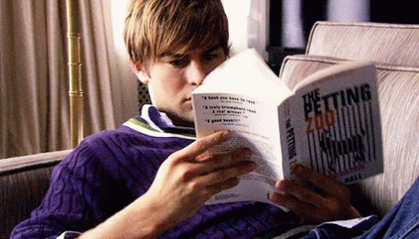
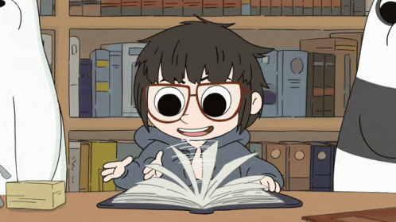
Act 1, Scene 1: Romeo and Love
Previously
Task: Using your highlighter, what oxymorons can you find in his speech? Highlight and label them.
What examples have you found?
Why does Shakespeare use oxymorons here?
LO: To identify oxymora and explore what these reveal about Romeo’s character

Slide 3
ROMEO
Alas, that love, whose view is muffled still,
Should, without eyes, see pathways to his will!
Where shall we dine? O me! What fray was here?
Yet tell me not, for I have heard it all.
Here's much to do with hate, but more with love.
Why, then, O brawling love! O loving hate!
O any thing, of nothing first create!
O heavy lightness! serious vanity!
Mis-shapen chaos of well-seeming forms!
Feather of lead, bright smoke, cold fire, sick health!
Still-waking sleep, that is not what it is!
This love feel I, that feel no love in this.
Dost thou not laugh?
Previously

Slide 4
Previously
ROMEO
Alas, that love, whose view is muffled still,
Should, without eyes, see pathways to his will!
Where shall we dine? O me! What fray was here?
Yet tell me not, for I have heard it all.
Here's much to do with hate, but more with love.
Why, then, O brawling love! O loving hate!
O any thing, of nothing first create!
O heavy lightness! serious vanity!
Mis-shapen chaos of well-seeming forms!
Feather of lead, bright smoke, cold fire, sick health!
Still-waking sleep, that is not what it is!
This love feel I, that feel no love in this.
Dost thou not laugh?
Contradictions and confusion, highlighting emotions and feelings of the character through oxymoron expressions
Oxymoron
Theme of antithesis
Opposing forces →
Opposing factions (capulets, Montagues)
Opposing lovers
Opposing ideals

Slide 5
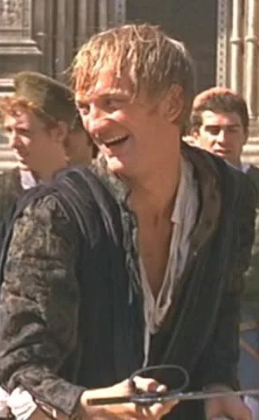
Act I, Scene IV: Mercutio
Who is MERCUTIO?
(2 min) Discuss with the person next to you!
THINK, PAIR, SHARE
Who is Mercutio and why is he important?
Pick three words to describe him!

Slide 6

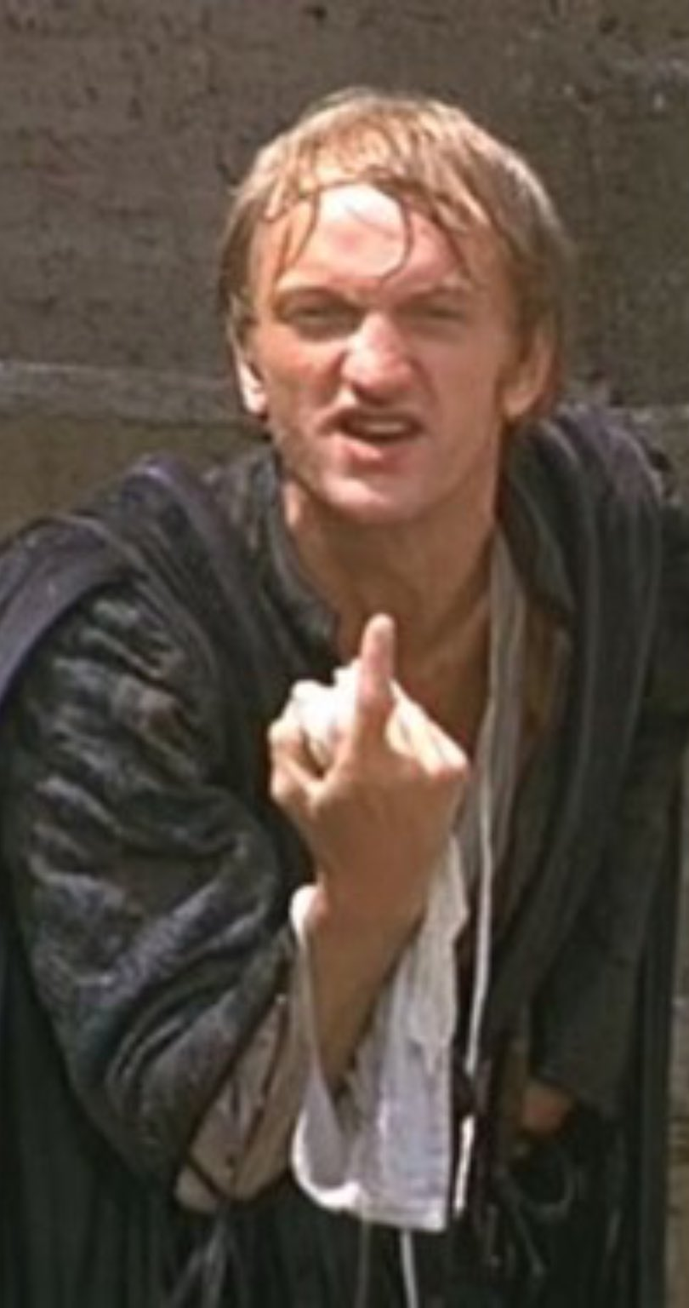
Act I, Scene IV: Mercutio
So how is Mercutio first introduced to us?
ROMEO
Give me a torch: I am not for this ambling;
Being but heavy, I will bear the light.
MERCUTIO
Nay, gentle Romeo, we must have you dance.
Take out your copy of Shakespeare’s R&J and go to Act I, Scene IV

Slide 7
Act I, Scene IV: Mercutio
In this simplified version of the scene, think about what impression Shakespeare is trying to give of Mercutio. Why do you think he does this?
Can you add any adjectives to your initial ideas?
ROMEO
Thou Talkst of Nothing
MERCUTIO
True, I talk of dreams,
Which are the children of an idle brain,
Begot of nothing but vain fantasy,
Which is as thin of substance as the air
ROMEO
I dream'd a dream to-night.
MERCUTIO
And so did I.
ROMEO
Well, what was yours?
MERCUTIO
That dreamers often lie.
1
3
ROMEO
Is love a tender thing? it is too rough,
Too rude, too boisterous, and it pricks like thorn.
MERCUTIO
If love be rough with you, be rough with love;
2
MERCUTIO
Or, save your reverence, love, wherein thou stickest
Up to the ears. Come, we burn daylight, ho!
4

Slide 8
Act I, Scene IV: Mercutio
Critically Analysing…
ROMEO
Give me a torch: I am not for this ambling;
Being but heavy, I will bear the light.
MERCUTIO
Nay, gentle Romeo, we must have you dance.
You will choose one quotation and write a PETAAL paragraph that links it to a thesis statement of Mercutio’s character builds tension and conflict in R&J
Analyse how the quote reveals qualities of Mercutio’s character
Remember - explaining what the word means does not get you any marks; you need to explain why it has been used and the impression it gives
Look at this following example:

Slide 9
Act I, Scene IV: Mercutio
(3 min) Discuss with the person next to you! THINK, PAIR, SHARE
ROMEO
Give me a torch: I am not for this ambling;
Being but heavy, I will bear the light.
MERCUTIO
Nay, gentle Romeo, we must have you dance.
How is Romeo feeling?
How is Mercutio feeling?
What can we learn about their relationship?
Where are they going?

Slide 10
Act I, Scene IV: Mercutio
ROMEO
Give me a torch: I am not for this ambling;
Being but heavy, I will bear the light.
MERCUTIO
Nay, gentle Romeo, we must have you dance.
Collective pronoun suggests that Mercutio views Romeo’s problems as his own
Shakespeare could be showing Mercutio has sympathy for his friend or could be suggesting a degree of sarcasm
This light-hearted tone suggests that Shakespeare wants to give an impression of Mercutio as frivolous and more carefree than Romeo.

Slide 11
Act I, Scene IV: Mercutio
ROMEO
Give me a torch: I am not for this ambling;
Being but heavy, I will bear the light.
MERCUTIO
Nay, gentle Romeo, we must have you dance.
Collective pronoun suggests that Mercutio views Romeo’s problems as his own
Shakespeare could be showing Mercutio has sympathy for his friend or could be suggesting a degree of sarcasm
This light-hearted tone suggests that Shakespeare wants to give an impression of Mercutio as frivolous and more carefree than Romeo.

Slide 12
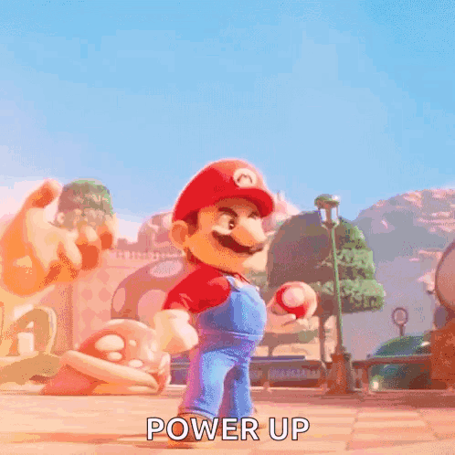


Act I, Scene IV: Mercutio
P
Point:
Evidence
Technique
Analysis
Audience / Reader Response
Link
E
T
Mastering this is the key to always providing good analysis and arguing a great point!
A
When analysing prose or poetry, make sure to clearly state your point, before quoting evidence with a identified technique to support your analysis. After analysing and explaining the relevancy of your evidence, comment on how audiences / readers interpret the technique and evidence before linking it back to your point!
A
L

Slide 13
Act I, Scene IV: Mercutio
To get over Romeo’s lovesickness for Rosaline, Mercutio urges Romeo to join the festivities at the Capulet party despite Romeo's reluctance, reflecting Mercutio's playful nature and disregard for Romeo's melancholy and societal expectations. Mercutio’s line, "Nay, gentle Romeo, we must have you dance," reveals his role as a catalyst for tension and foreshadows the conflict in the play. Mercutio employs imperative language with "we must have you dance," strongly indicating a level of assertiveness and confidence. By insisting that Romeo dance, Mercutio not only attempts to uplift his friend’s spirits but also emphasizes the recurring theme of social interaction and its antithesis, isolation. His command suggests a pressure to conform to societal expectations, serving as a reminder of the public versus private self. This line underscores Mercutio's role as a foil to Romeo—where Romeo is introspective and romantic while Mercutio embodies a more carefree and provocative spirit, allowing audiences to recognise the opposing personalities between the two friends. Additionally, Mercutio’s insistence on dancing foreshadows the tumultuous events that will unfold later on in the play. Ultimately, Mercutio’s playful insistence on dancing encapsulates his character's complexity and sets up the dramatic tension that permeates the play as he gets Romeo to the Capulet’s party to meet Juliet, illustrating how one spontaneous event insisted through social interaction amongst friends can lead to unforeseen consequences in a world governed by familial loyalty and conflict.
P
To get over Romeo’s lovesickness for Rosaline, Mercutio urges Romeo to join the festivities at the Capulet party despite Romeo's reluctance, reflecting Mercutio's playful nature and disregard for Romeo's melancholy and societal expectations. Mercutio’s line, "Nay, gentle Romeo, we must have you dance," reveals his role as a catalyst for tension and foreshadows the conflict in the play. Mercutio employs imperative language with "we must have you dance," strongly indicating a level of assertiveness and confidence. By insisting that Romeo dance, Mercutio not only attempts to uplift his friend’s spirits but also emphasizes the recurring theme of social interaction and its antithesis, isolation. His command suggests a pressure to conform to societal expectations, serving as a reminder of the public versus private self. This line underscores Mercutio's role as a foil to Romeo—where Romeo is introspective and romantic while Mercutio embodies a more carefree and provocative spirit, allowing audiences to recognise the opposing personalities between the two friends. Additionally, Mercutio’s insistence on dancing foreshadows the tumultuous events that will unfold later on in the play. Ultimately, Mercutio’s playful insistence on dancing encapsulates his character's complexity and sets up the dramatic tension that permeates the play as he gets Romeo to the Capulet’s party to meet Juliet, illustrating how one spontaneous event insisted through social interaction amongst friends can lead to unforeseen consequences in a world governed by familial loyalty and conflict.
E
T
A
A
L

Slide 14

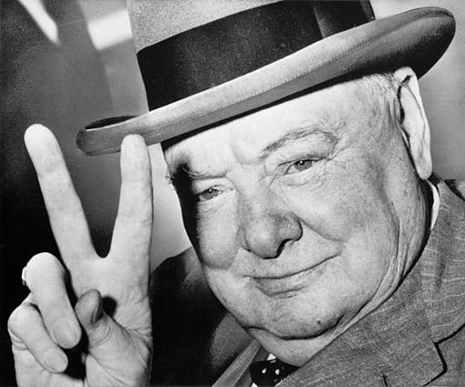
Victory Verbs!
“shows” is boring.
Go for victory in your essays by using a range of verbs to express your points.
The writer/play… |  | Opinion adjective | The language/structure… | The audience…
suggests | indicates | interesting (ly) | supports | infers
invokes | portrays | powerful (ly) | connotes | interprets
subverts | represents | vivid (ly) | validates | is impacted by…
implies | juxtaposes | thoughtful (ly) | enhances | deduces
highlights | contrasts | thought-provoking (ly) | evokes | establishes
presents | reflects | inspiring (ly) |  | wonders
attests to | emphasises |  |  | establishes
conveys | expounds
depicts | alludes to
demonstrates | illustrates
evinces | postulates
challenges | interrogates
.

Slide 15
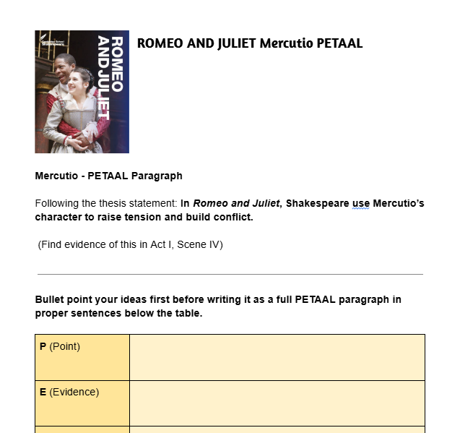
Act I, Scene IV: Mercutio
Critically Analysing…
REMINDER!
You will choose one quotation and write a PETAAL paragraph that links it to a thesis statement of Mercutio’s character builds tension and conflict in R&J
Analyse how the quote reveals qualities of Mercutio’s character
Remember - explaining what the word means does not get you any marks; you need to explain why it has been used and the impression it gives

